Slide 1
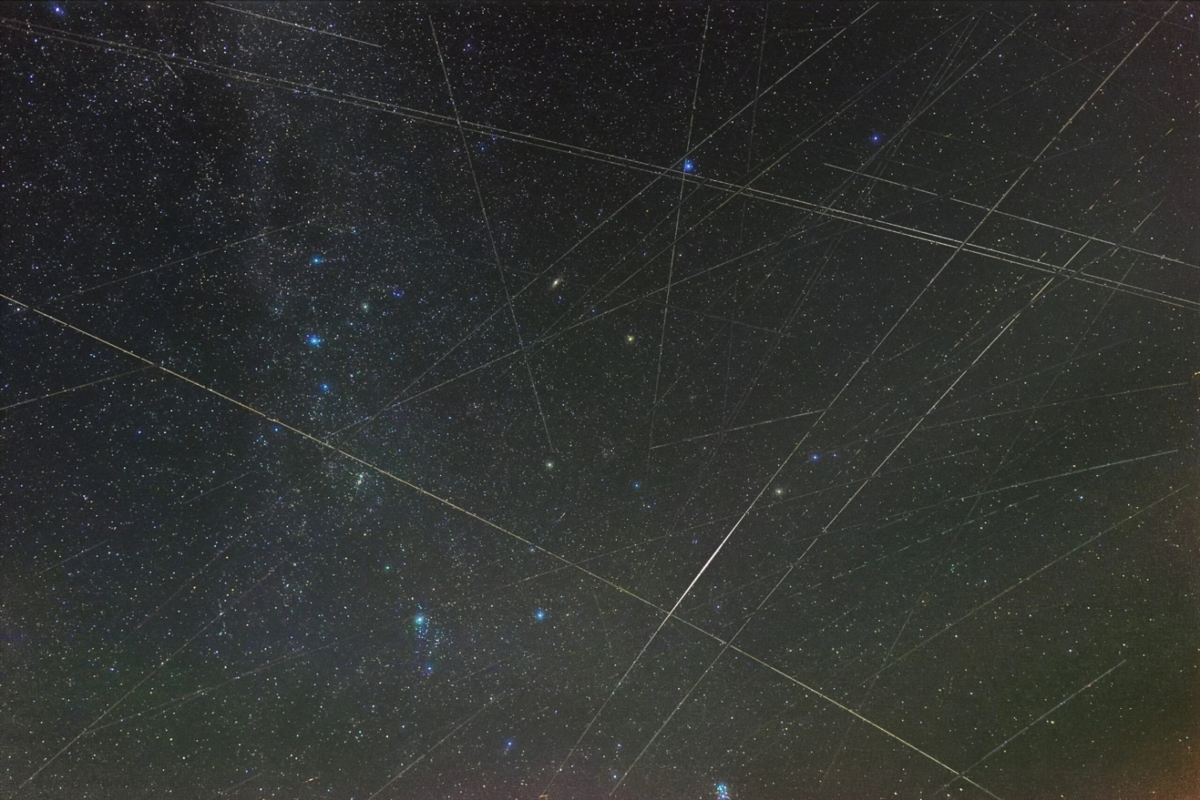
TCP and Starlink
Geoff Huston AM
APNIC

Slide 2
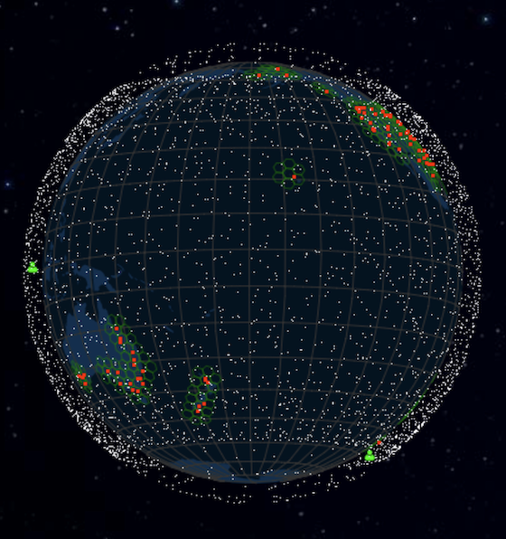
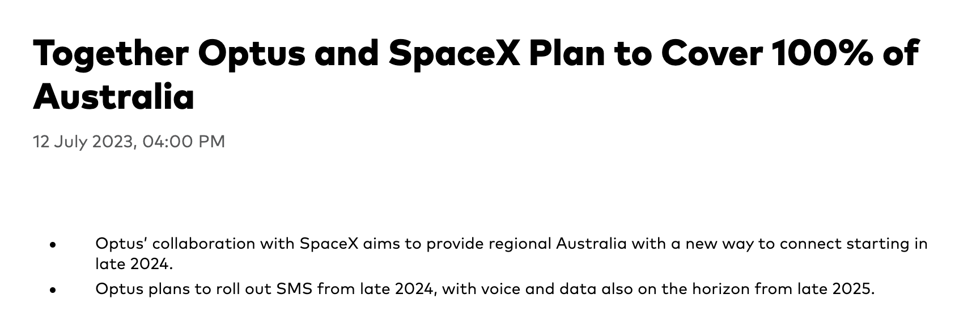
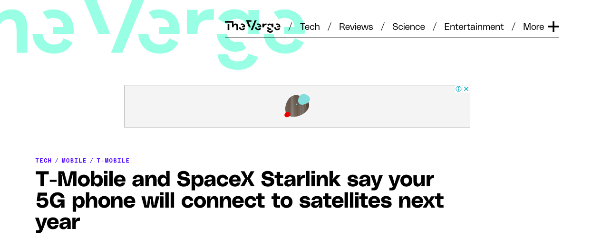
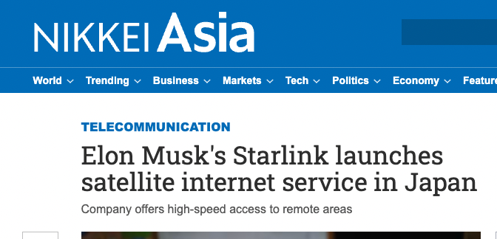
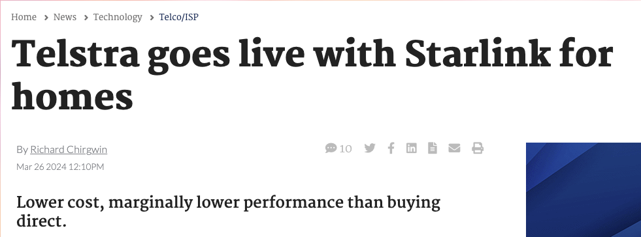
LEOs in the News
screenshot from starwatch app
Screenshot - https://www.theverge.com/2022/8/25/23320722/spacex-starlink-t-mobile-satellite-internet-mobile-messaging
Screenshot: https://asia.nikkei.com/Business/Telecommunication/Elon-Musk-s-Starlink-launches-satellite-internet-service-in-Japan
https://www.itnews.com.au/news/telstra-goes-live-with-starlink-for-homes-606423#:~:text=Telstra%20has%20kicked%20off%20its,the%20end%20of%20the%20year.

Slide 3
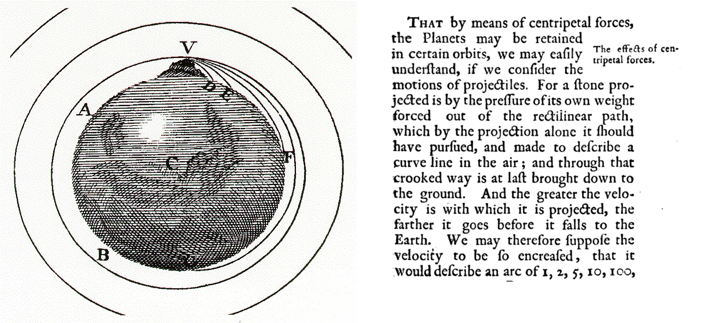
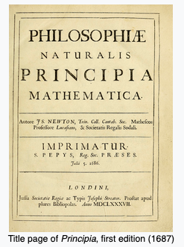
Newtonian Physics
If you fire a projectile with a speed greater than 11.2Km/sec it will not fall back to earth, and instead head away from earth never to return
On the other hand, if you incline the aiming trajectory and fire it at a critical speed it will settle into an orbit around the earth
The higher the altitude, the lower the orbital speed required to maintain orbit

Slide 4
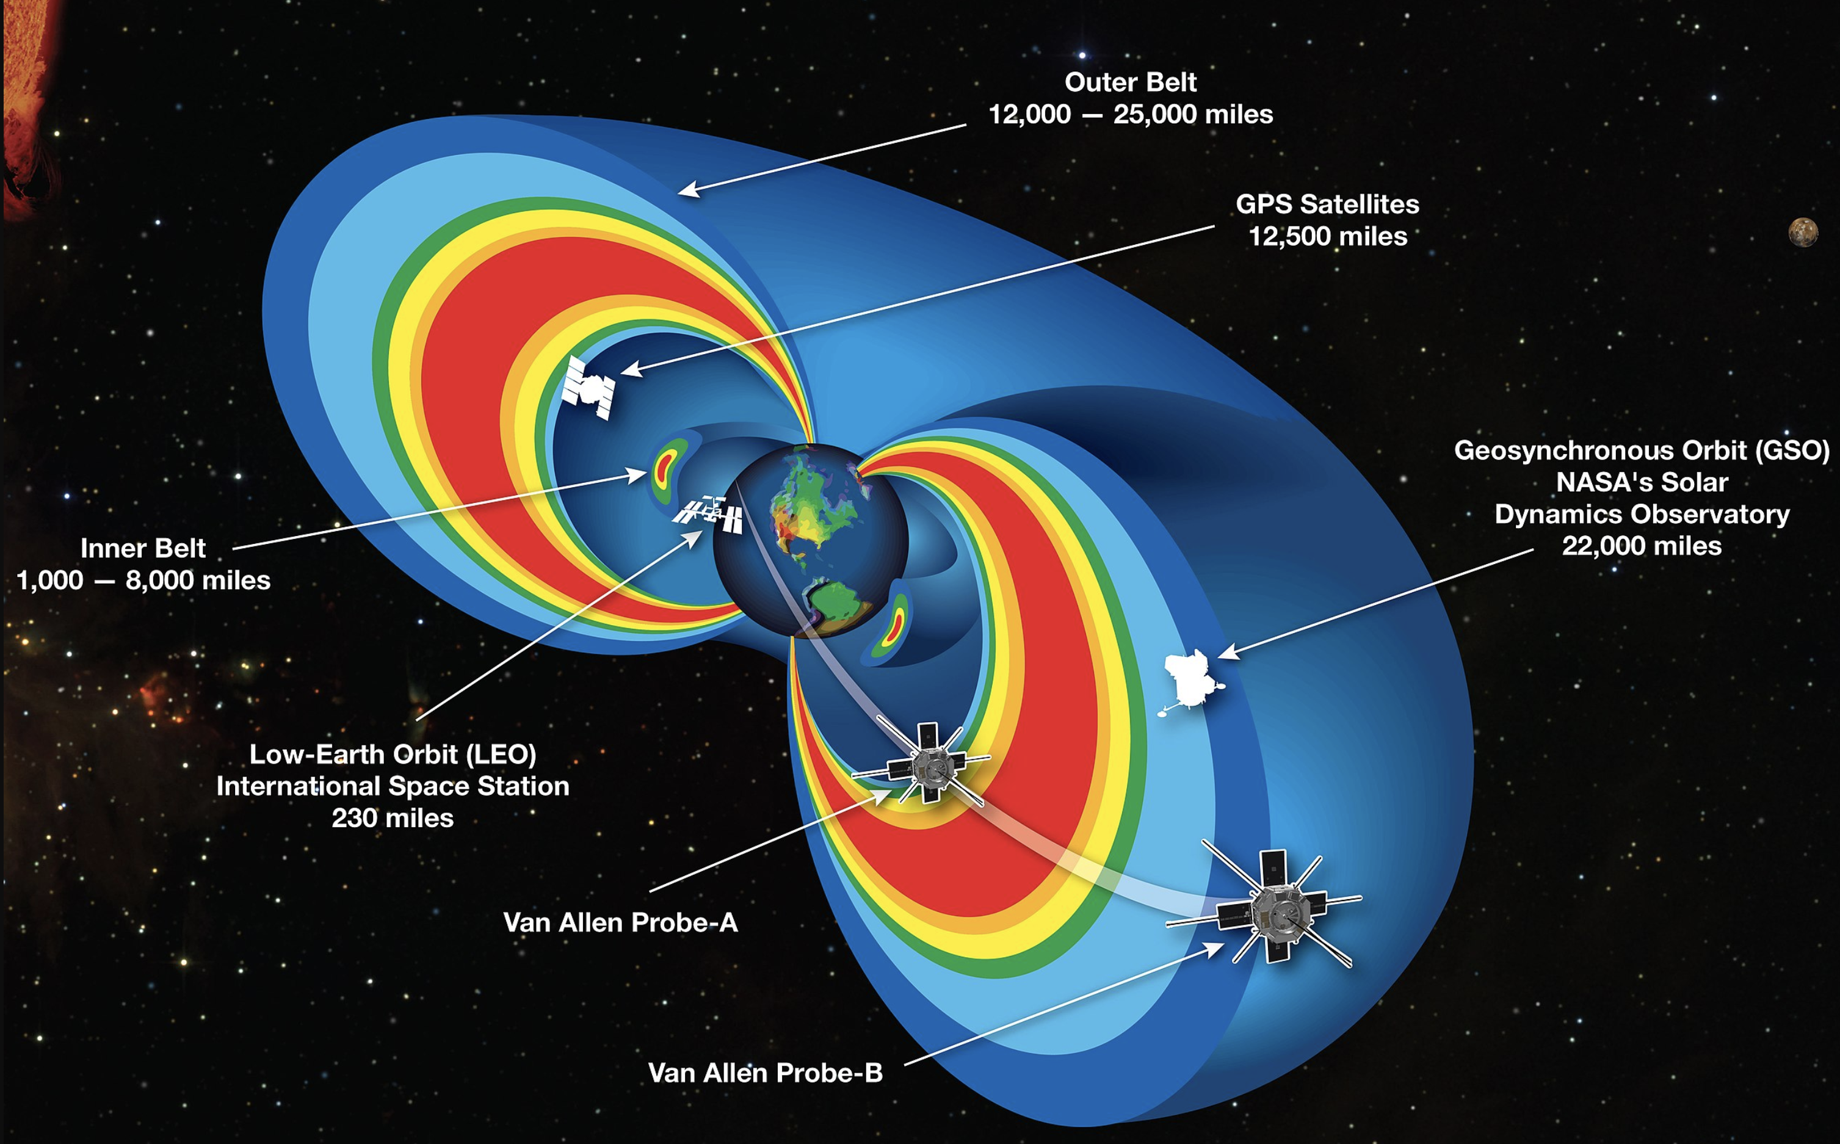
Solar Radiation Physics
The rotating iron core of the Earth produces a strong magnetic field
This magnetic field deflects solar radiation – the Van Allen Belt
Sheltering below the Van Allen Belt protects the spacecraft from the worst effects of solar radiation, allowing advanced electronics to be used in the spacecraft

Slide 5
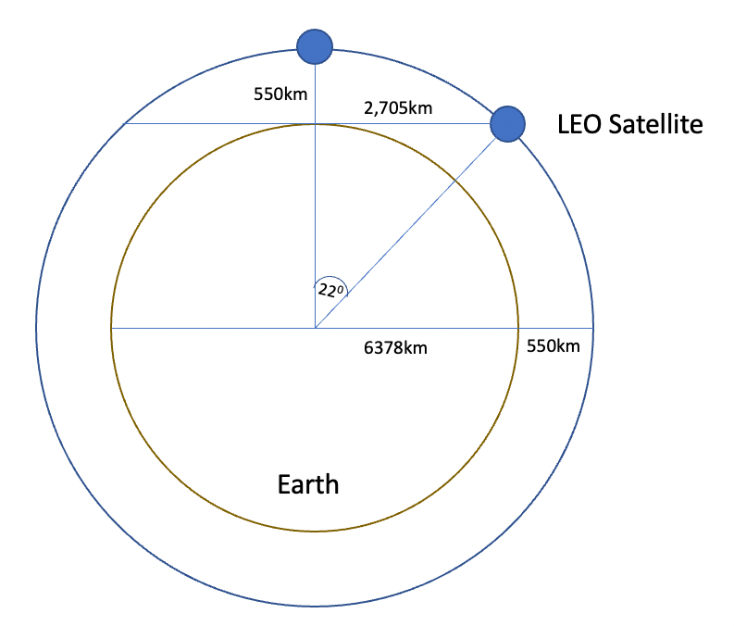
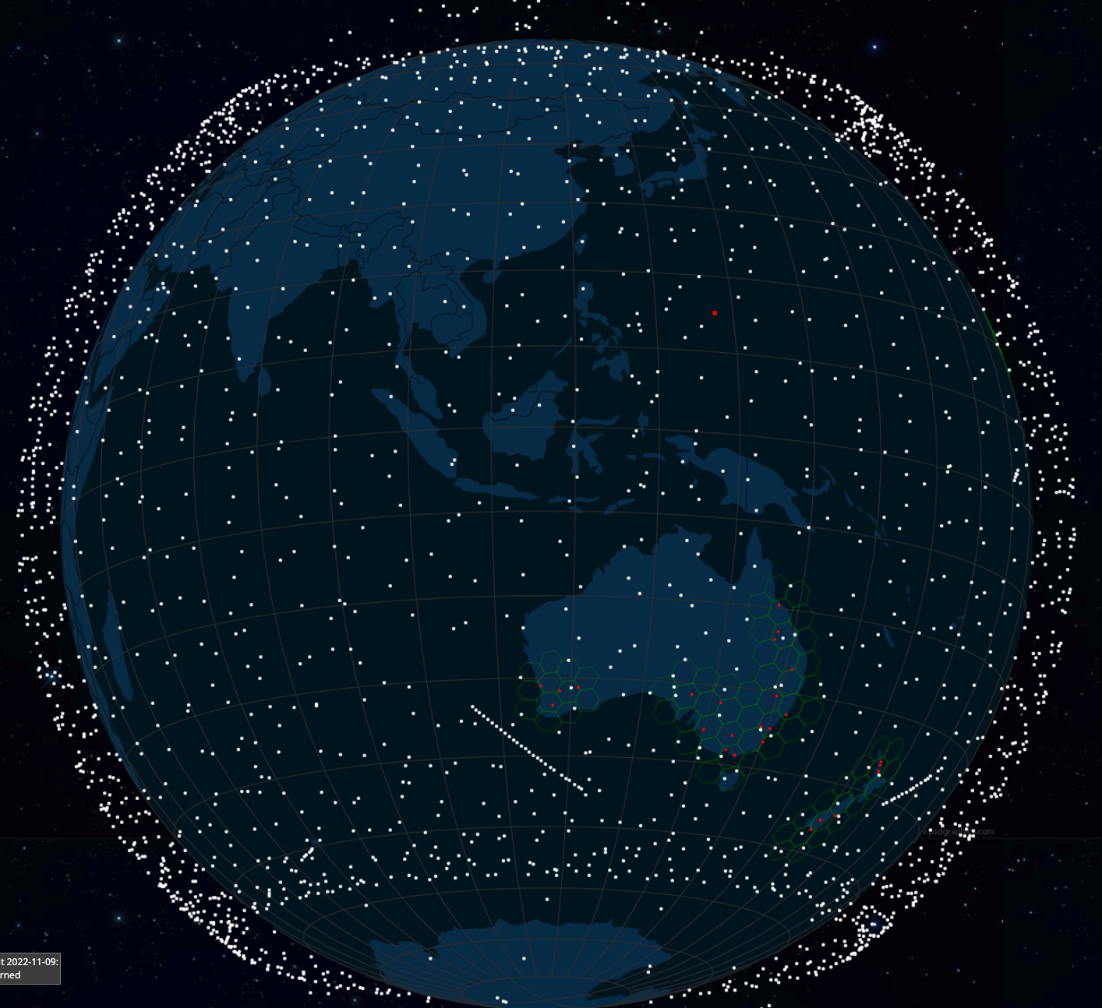
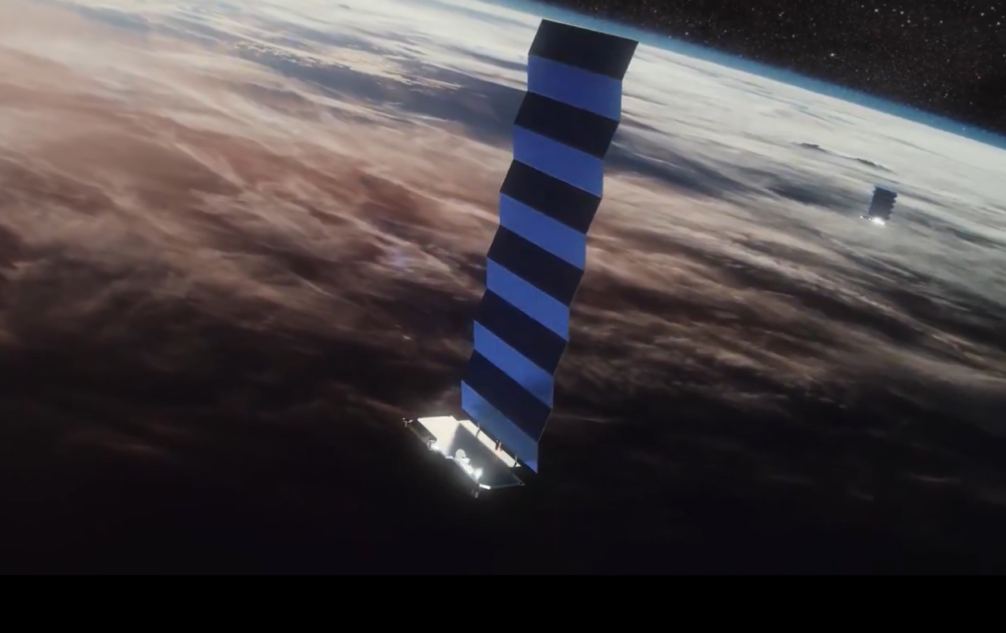
Low Earth Orbit
LEO satellites are stations between 160km and 2,000km in altitude.
High enough to stop it slowing down by “grazing” the denser parts of the earth’s ionosphere
Not so high that it loses the radiation protection afforded by the Inner Van Allen belt.
At a height of 550km, the minimum signal propagation delay to reach the satellite and back is 3.7ms, at 25º it’s 7.5ms.
Image - spacex
screenshot from starwatch app

Slide 6
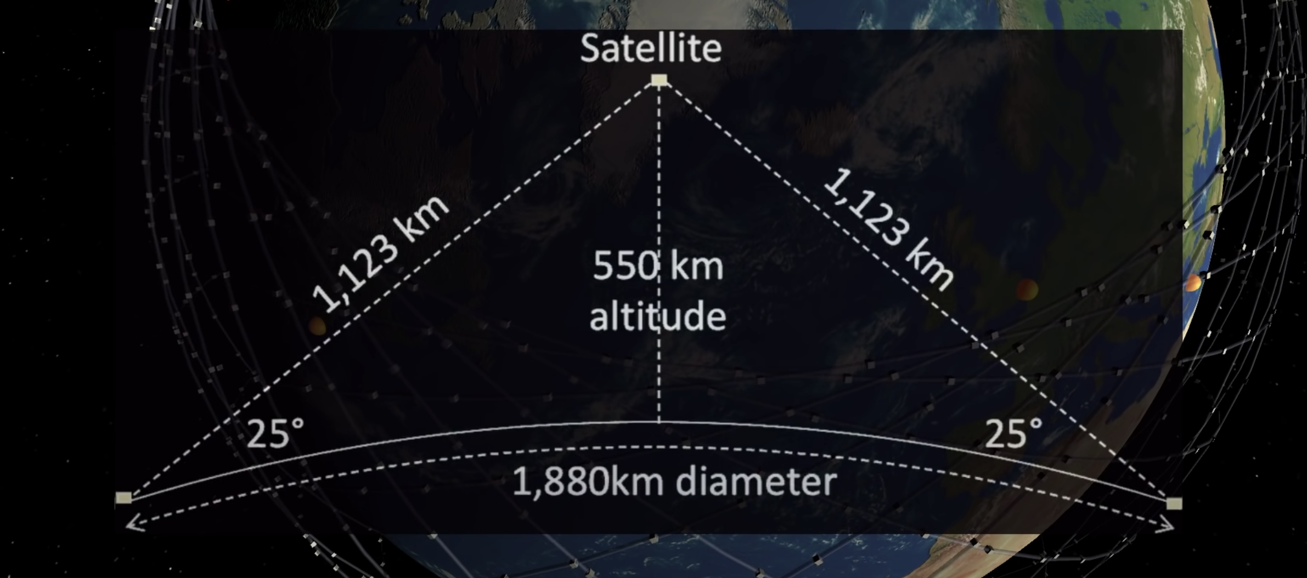
Starlink Constellation
If you use a minimum angle of elevation of 25º then at an altitude of 550km each satellite spans a terrestrial footprint of no more than ~900Km radius, or 2M K²
At a minimum, a LEO satellite constellation needs 500 satellites to provide coverage of all parts of the earth’s surface
For high quality coverage the constellation will need 6x-20x that number (or more!)

Slide 7
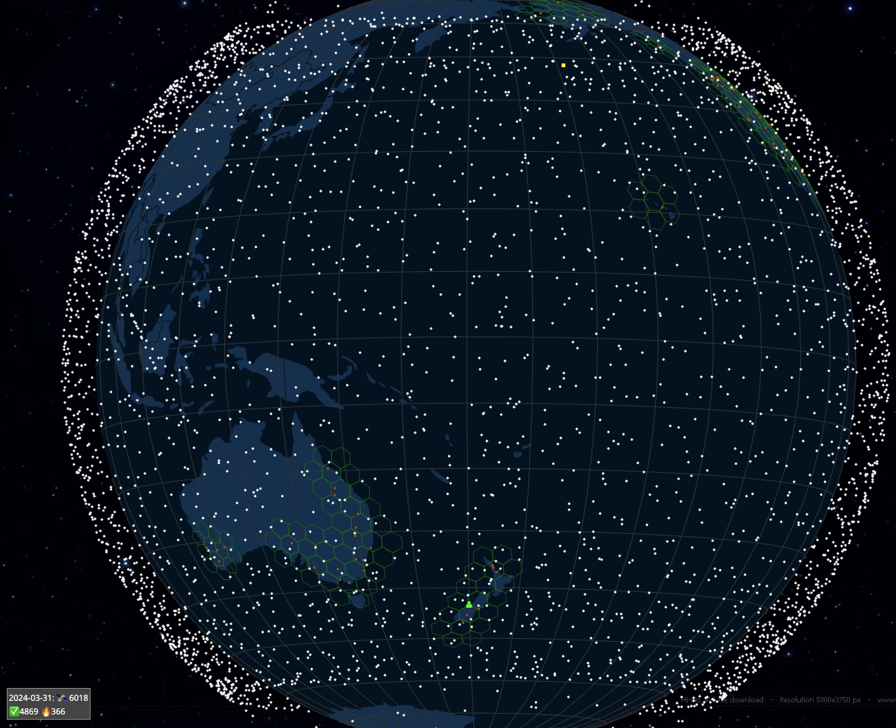
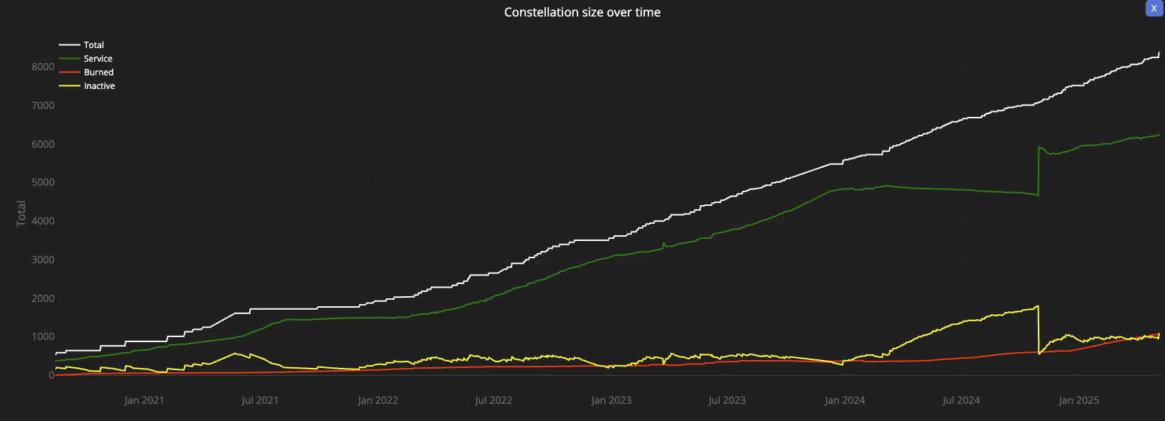
Starlink Constellation
6,231 in-service operational spacecraft, operating at an altitude of 550km
https://satellitemap.space/

Slide 8
So LEOs are “interesting”!
They are very close to the Earth – which means:
  They can achieve very high signal speeds
    It’s a highly focussed signal beam
  They are harder to disrupt by external interference
  They don’t need specialised high-power equipment to send and receive signals
    Even hand-held mobile devices can send and receive signals with a LEO (slowly!)
But you need a large number of them to provide a continuous service
The extremely high cost of launching a large constellation of LEO spacecraft has been the major problem with LEO service until recently
  Which is why Motorola’s Iridium service went bankrupt soon after launch

Slide 9
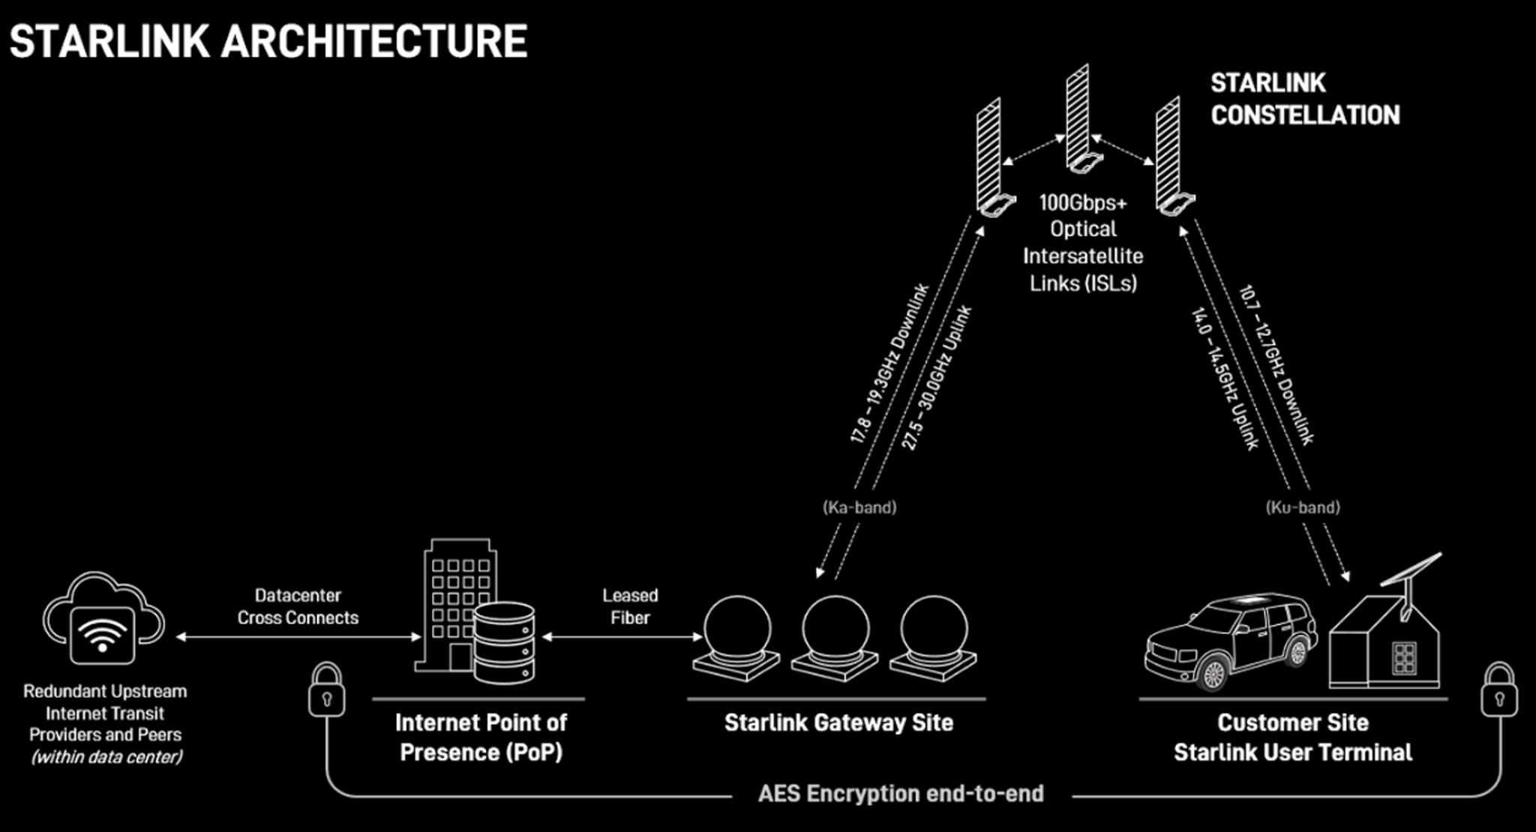
Starlink Architecture

Slide 10
Tracking a LEO satellite
Satellite
27,000 km/h
horizon to horizon: ~5 minutes
550km

Slide 11
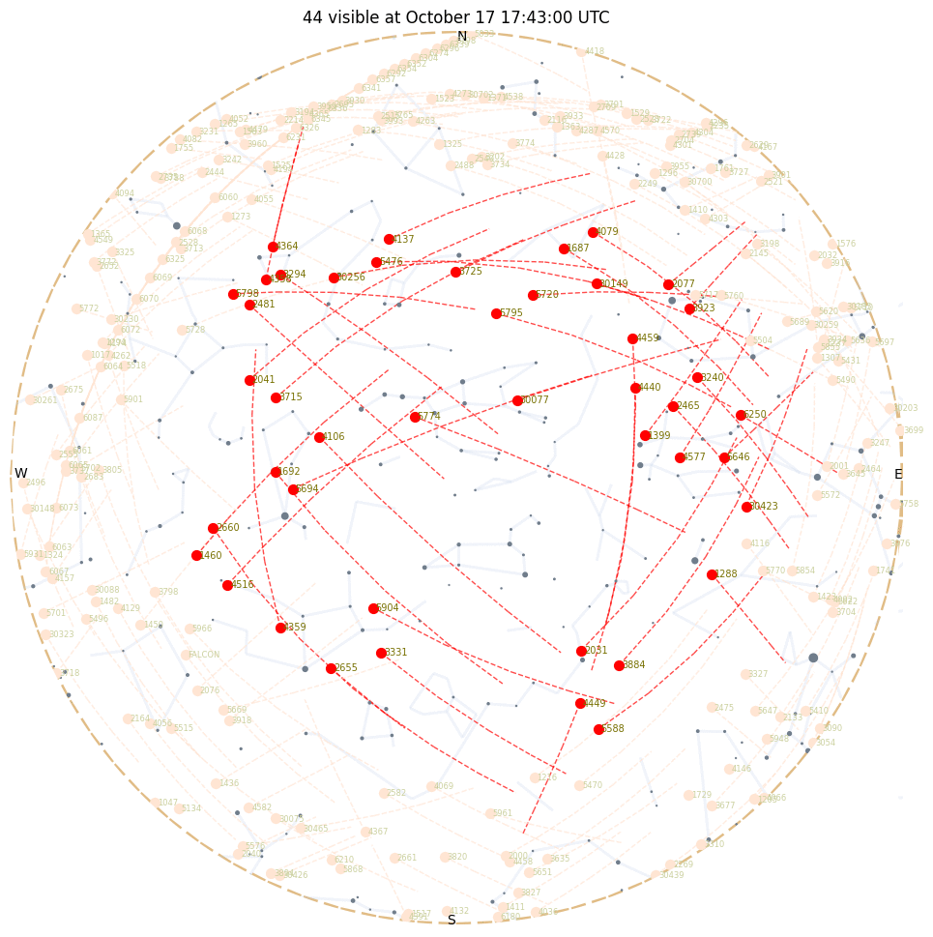
Looking Up
Starlink tracks satellites with a minimum elevation of 25º.
There are between 30 – 50 visible Starlink satellites at any point on the surface between latitudes 56º North and South
Each satellite traverses the visible aperture for a maximum of ~3 minutes

Slide 12
Starlink Scheduling
A satellite is assigned to a user terminal in 15 second time slots
Tracking of a satellite (by phased array focussing) works across 11 degrees of arc per satellite in each 15 second slot
15 seconds
11º
client

Slide 13
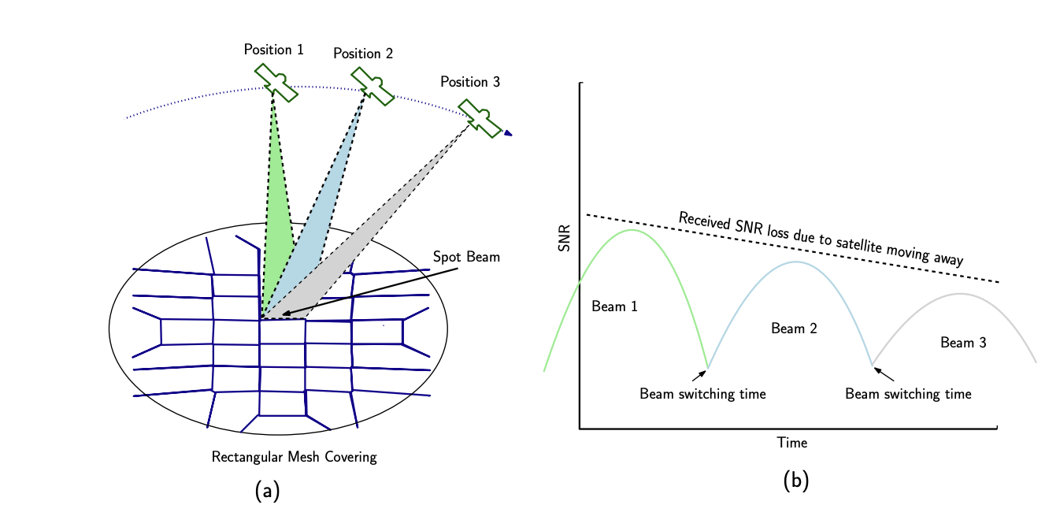
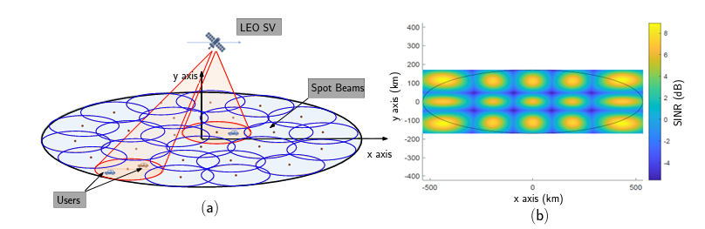
Starlink Spot Beams
Each spacecraft uses 2,000 MHz of spectrum for user downlink and splits it into 8x channels of 250 MHz each
Each satellite has 3 downlink antennas and 1 uplink antennas, and each can do 8 beams x 2 polarizations, for a total of 48 beams down and 16 up.
“Unveiling Beamforming Strategies of Starlink LEO Satellites”
https://people.engineering.osu.edu/sites/default/files/2022-10/Kassas_Unveiling_Beamforming_Strategies_of_Starlink_LEO_Satellites.pdf

Slide 14
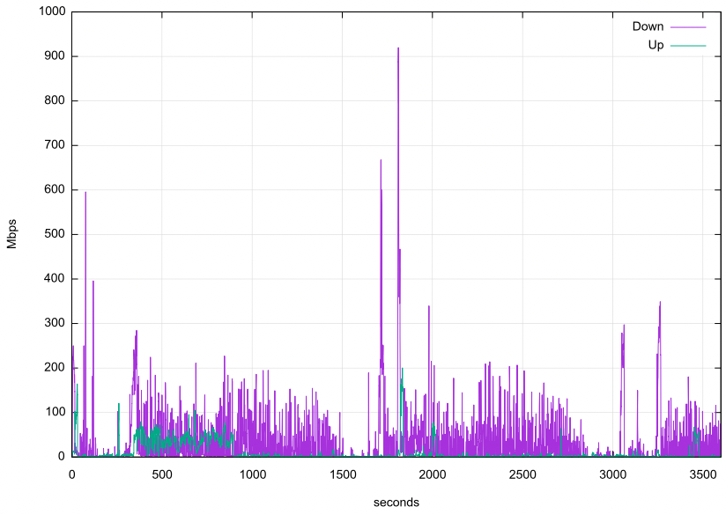
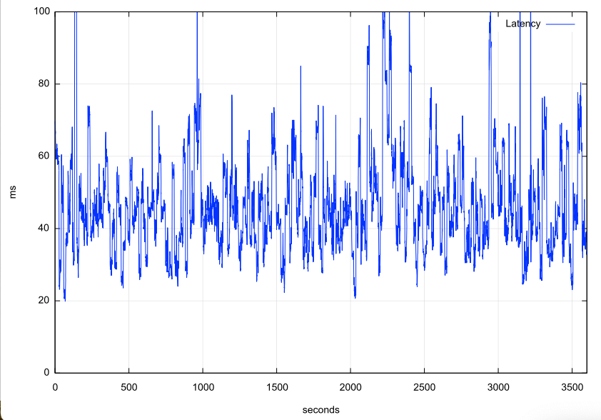
Reported Capacity & Latency

Slide 15
Reported Capacity & Latency
Why is the Starlink carrier so unstable?

Slide 16
Starlink Scheduling
Latency changes on each satellite switch
If we take the minimum latency on each 15 second scheduling interval, we can expose the effects of the switching interval on latency
Across the 15 second interval there will be a drift in latency according to the satellite’s track and the distance relative to the two earth points
Other user traffic will also impact on latency, and also the effects of a large buffer in the user modem
Jitter
Loss

Slide 17
Satellite handover

Slide 18
Varying SNR
Starlink likely uses IEEE 802.11ac dynamic channel rate control, adjusting the signal modulation to match the current SNR
This continual adjustment causes continual shift in the available capacity and imposes a varying latency on the round-trip time

Slide 19
Frames
Starlink does NOT provide each user with a dedicated frequency band
The system uses Multiplexing to divide a channel into frames, and sends 750 frames per second. Each frame is divided into 302 intervals.
Each frame carries a header that carrier satellite, channel and modulation information

Slide 20
Starlink Characteristics
Varying SNR produces varying modulation, which is expressed as varying capacity and delay
Relative motions of earth and spacecraft add to varying latency
15 second satellite handover generates regular loss and latency extension
Contention for common transmission medium leads to queuing delays

Slide 21
TCP is the Internet
The Transmission Control Protocol is an end-to-end protocol that creates a reliable stream protocol from the underlying IP datagram device
This single protocol is the “beating heart” at the core of the Internet
TCP operates as an adaptive rate control protocol that attempts to operate efficiently and fairly

Slide 22
TCP Performance Objectives
To maintain an average flow which is both Efficient and Fair
Efficient:
  Minimise packet loss
  Minimise packet re-ordering
  Do not leave unused path bandwidth on the table!
Fair:
  Do not crowd out other TCP sessions
  Over time, take an average 1/N of the path capacity when there are N other TCP sessions sharing the same path

Slide 23
It’s a Flow Control process
Think of this as a multi-flow fluid dynamics problem
Each flow has to gently exert pressure on the other flows to signal them to provide a fair share of the network, and be responsive to the pressure from all other flows

Slide 24
TCP Control
TCP is an ACK Pacing protocol
If the sender sends one packet each time it receives an ACK, then the sender will maintain a steady number of packets in flight within the network
Data sending rate is matched to the ACK arrival rate

Slide 25
TCP and Starlink
TCP uses ACK pacing which means it attempts to optimize its sending rate over multiple RTT intervals
  TCP assumes a stable carrier with low jitter and a stable channel capacity
  When this is not the case TCP tends to reduce its sending rate to achieve stability
The variation in latency and capacity occurs at high frequency, which means that TCP control is going to struggle to optimize itself against a shifting target

Slide 26
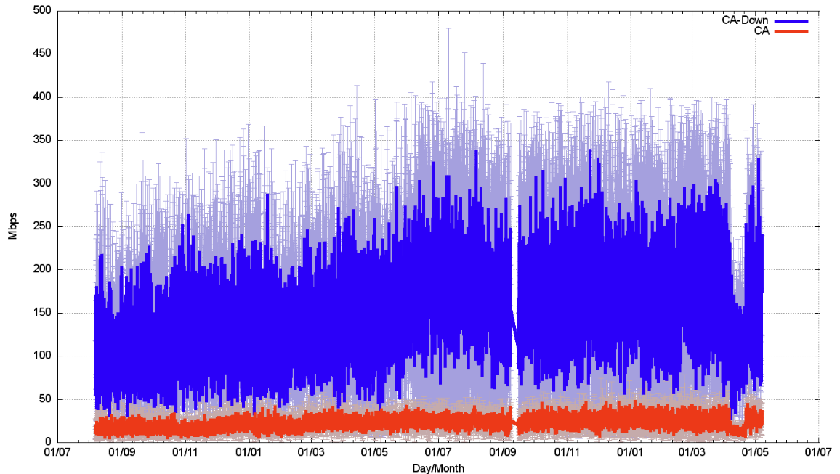
How well does Starlink work?
Speedtest measurements:
We should be able to get ~180Mbps out of a Starlink connection.
But Speedtest is NOT TCP – so lets look at TCP performance

Slide 27
“Classic TCP” – TCP Reno
Additive Increase Multiplicative Decrease (AIMD)
  While there is no packet loss, increase the sending rate by one segment (MSS) each RTT interval
  If there is packet loss (detected by duplicate ACKs) pause for 1xRTT and decrease the sending rate by 50% over the next RTT Interval by halving the sender’s send window
Start Up
  Each RTT interval, double the sending rate
  We call this “slow start” – probably because its anything but slow!!!

Slide 28
The Classic TCP Picture
Queue formation
Queue drain

Slide 29
CUBIC
CUBIC is designed to be useful for high-speed sessions while still being ‘fair’ to other sessions and also efficient even at lower speeds
Rather than probe in a linear manner for the sending rate that triggers packet loss, CUBIC uses a non-linear (cubic) search algorithm

Slide 30
CUBIC and Queue formation
Total Queue Capacity
(Onset of Packet Loss)
Network Buffers Fill
Link Capacity Capacity
(Onset of Queuing)
Network Buffers Drain

Slide 31
CUBIC assessment
Can react quickly to available capacity in the network
Tends to sit for extended periods in the phase of queue formation
Can react efficiently to long fat pipes and rapidly scale up the sending rate
Operates in a manner that tends to exacerbate ‘buffer bloat’ conditions

Slide 32
And there’s a whole lot more…

Slide 33
Optimising Flow State
There are three ‘states’ of flow management:
  Under-Utilised – where the flow rate is below the link capacity and no queues form
  Over-Utilised – where the flow rate is greater than the link capacity and queues form
  Saturated – where the queue is filled and packet loss occurs
Loss-based control systems probe upward to the Saturated point, and back off quickly to what they guess is the Under-Utilised state in order to the let the queues drain
But the optimal operational point for any flow is at the point of state change from Under to Over-utilised, not at the Saturated point
We can detect this point by careful handling of delay – the onset of queuing causes additional delay in the observed round-trip time

Slide 34
RTT and Delivery Rate with Queuing
Under-Utilised
Over-Utilised
Saturated

Slide 35
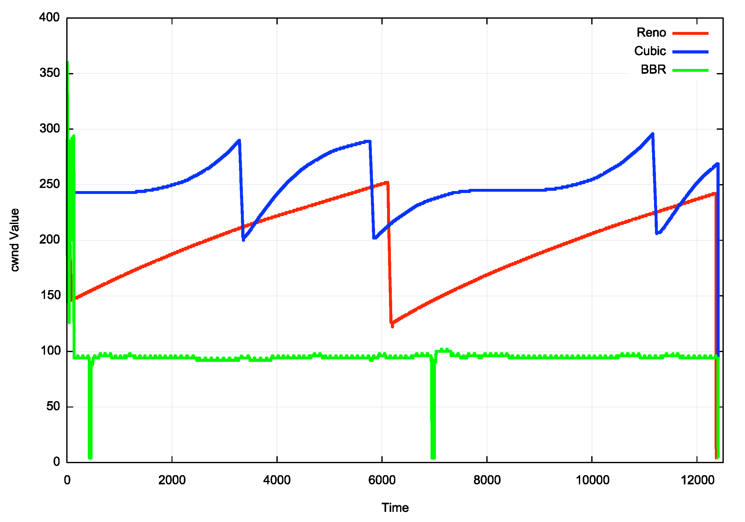
TCP Flow Control Algorithms
“Ideal” Flow behaviour for each protocol
RENO and CUBIC are loss-based control algorithms where the uppoer limit in the send rate is established by encountering packet loss
BBR is a delay based control algorithm where the upper send limit is established by the onset of increased delay

Slide 36
Starlink using iperf3 – cubic, 40 seconds

Slide 37
Starlink using iperf3 – cubic, 40 seconds
Slow Start
Queue Drain
Congestion Avoidance

Slide 38
Starlink with iperf3 – bbr, 40- seconds

Slide 39
Starlink with iperf3 – bbr, 40- seconds
15 second switch

Slide 40
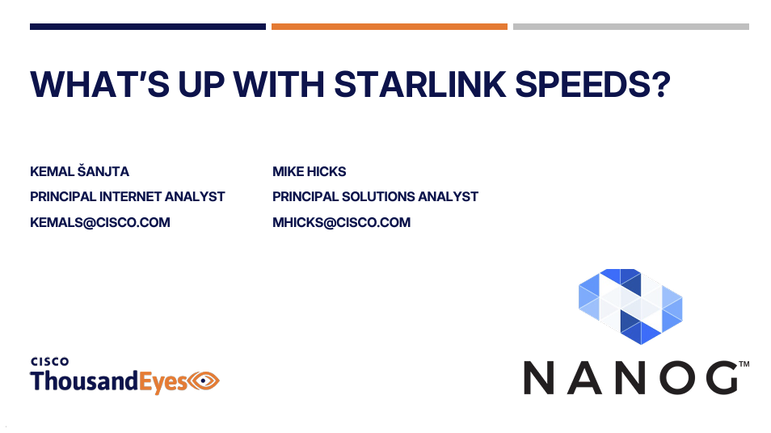
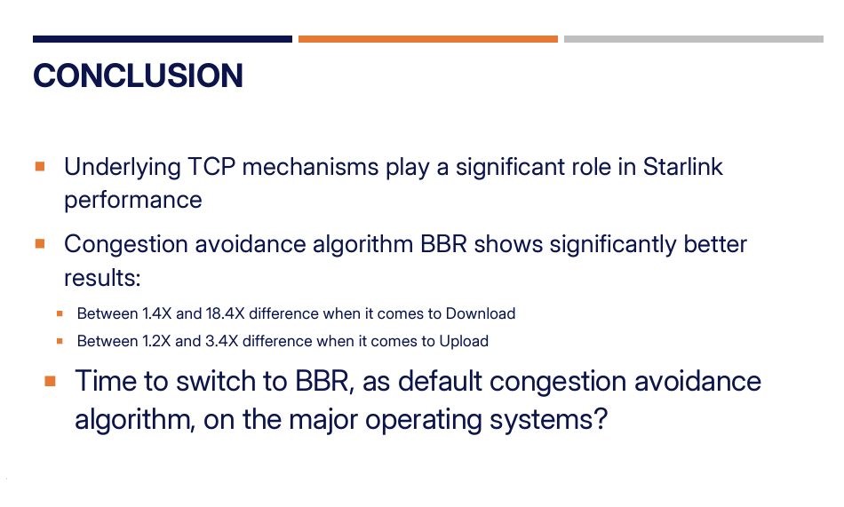
From NANOG 92…

Slide 41
From NANOG 92…
WHY does BBR outperform CUBIC on Starlink systems?

Slide 42
BBR Characteristics
BBR is not sensitive to packet loss, so the regular packet loss events every 15 seconds do not impact BBR performance
BBR uses even pacing of sent packets, so does not use network buffers to smooth out sender bursts
BBR does not perform continuous delay monitoring, but instead “spikes” the sending rate every 8 RTT intervals by a massive 25%
  BBR only checks for a change in delay during this spike interval
This allows BBR to operate an internal model of channel capacity that is based on averaging across 8xRTT intervals, reducing its sensitivity to jitter and high frequency capacity changes

Slide 43
Protocol Considerations
Starlink services have three issues:
  Very high jitter rates – varying signal modulation
  High levels of micro-loss (1.4%) – largely due to 15s satellite handover events
  Common bearer contention between users
Loss-based flow control algorithms will over-react and pull back the sending rate over time
  Short transactions work very well
  Paced connections (voice, zoom, video streaming) tend to work well most of the time
To obtain better performance you need to move to flow control algorithms that are not loss-sensitive, such as BBR

Slide 44
Other considerations
Senders should use fair queuing to pace sending rates and avoid bursting and tail drop behaviours
SACK (selective acknowledgement) for TCP can help in rapid repair to multiple lost packets
Its likely that ECN would also be really helpful to disambiguate latency changes due to satellite behaviours and network queue buildup

Slide 45
Starlink Performance
Starlink is perfectly acceptable for:
  short transactions
  video streaming
  conferencing
The service can sustain 40 – 50Mbps delivery for long-held sessions during local peak use times in high density use scenarios
  The isolated drop events generally do not intrude into the session state
In off-peak and/or low-density contexts it can deliver 200-300Mbps
It can be used in all kinds of places where existing wire and mobile radio systems either under-perform or aren’t there at all!
Its probably not the best trunk infrastructure service medium, but it’s a really good high speed last mile direct retail access service, particularly for remote locations!

Slide 46
Making Starlink Faster
Increase antennae transmitter power
Use higher gain antennae with narrower beams
Drop the orbital altitude to 340Km
Drop the minimum elevation angle from 25º to 20º
Use more bands (Ka-, V-, and E- bands)
(Proposed measures described in an October 2024 FCC application by Starlink)

Slide 47
Questions?

