Slide 1
Whatever happened to IPv6?
Geoff Huston AM
Chief Scientist, APNIC

Slide 2
Projecting IPv6 Adoption
We are here
% of the Internet’s User Base with IPv6
IPv6 Adoption over the past decade
2045!
Year

Slide 3
This is unexpected
Back in the early nineties when the Internet was just picking up momentum NOBODY could conceive that a transition to IPv6 would take longer than five years - tops!
A total timeframe to complete this transition from start to finish of fifty years was unthinkable!
But that is where we are
What went wrong?

Slide 4
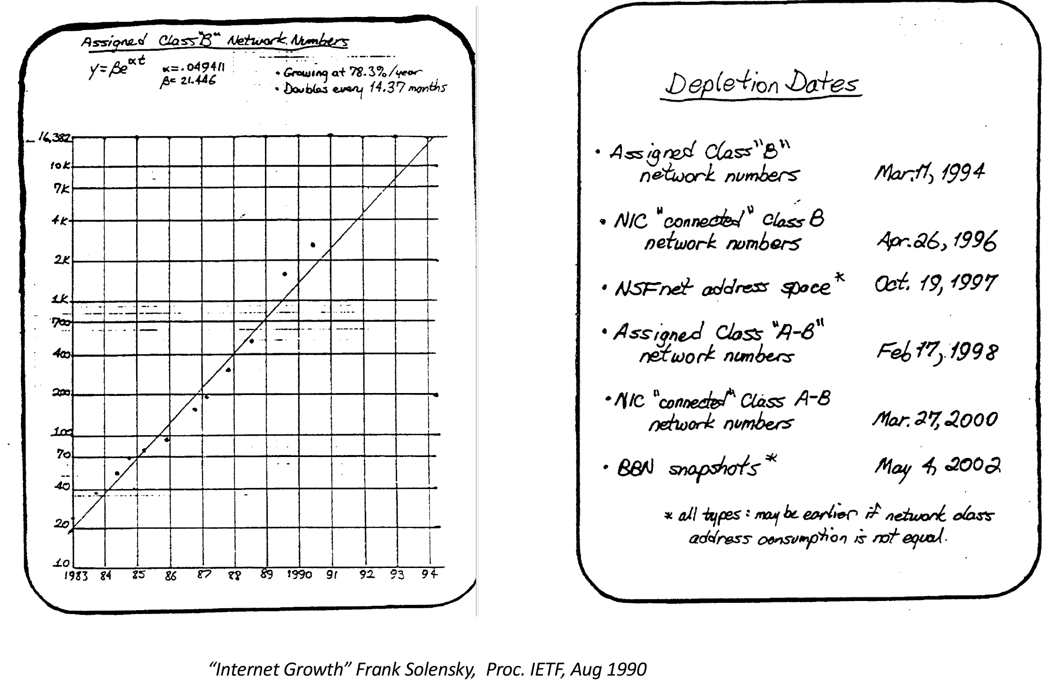
We started early
The Internet was only just gathering momentum in 1990 we were told that the address plan had just a few years to run before the Class B address pool would be fully depleted

Slide 5
We worked quickly
The ROAD effort in the IETF had produced candidate IPng protocols by 1992
And by 1994 we had managed reach a rough consensus on what to do…
Reduce the speed of address runout by dropping Class A, B and C structured addresses in address deployment and routing and replacing it by variable sized network/host identifiers
Adopt a successor IP protocol with a larger address field…

Slide 6
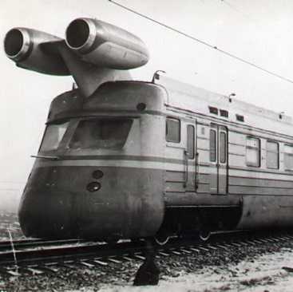
IPv6!
RFC 1883, December 1995

Slide 7
IPv6 was incremental
Minimal changes to IP:
Expand the address fields four-fold to 128 bits
64-bit network prefix, 64-bit interface identifier
Remove packet fragmentation-on-the-fly
Replace ARP with Multicast
BUT
It was NOT backward compatible with IPv4!

Slide 8
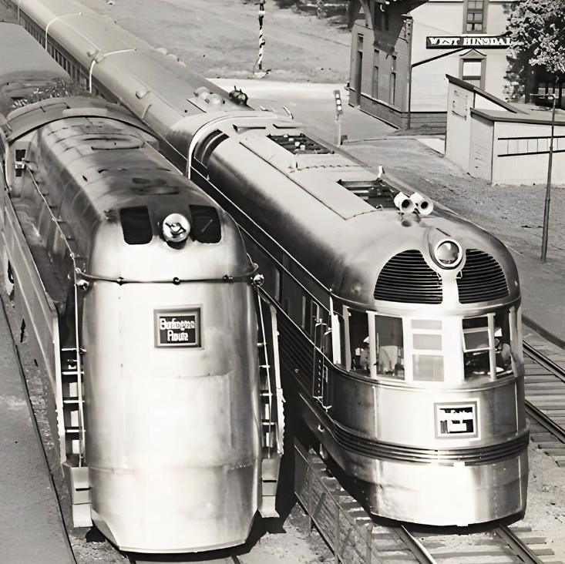
Transition using Dual Stack
The plan was that we needed to run some form of a “dual stack” transition process
Network-level proxies/translators were deemed to be too insecure
Which meant that we needed to equip EVERY host and EVERY network with two protocol stacks
But the network was too big to ”just do it” so we devised a dual stack transition plan that allowed for piecemeal adoption

Slide 9
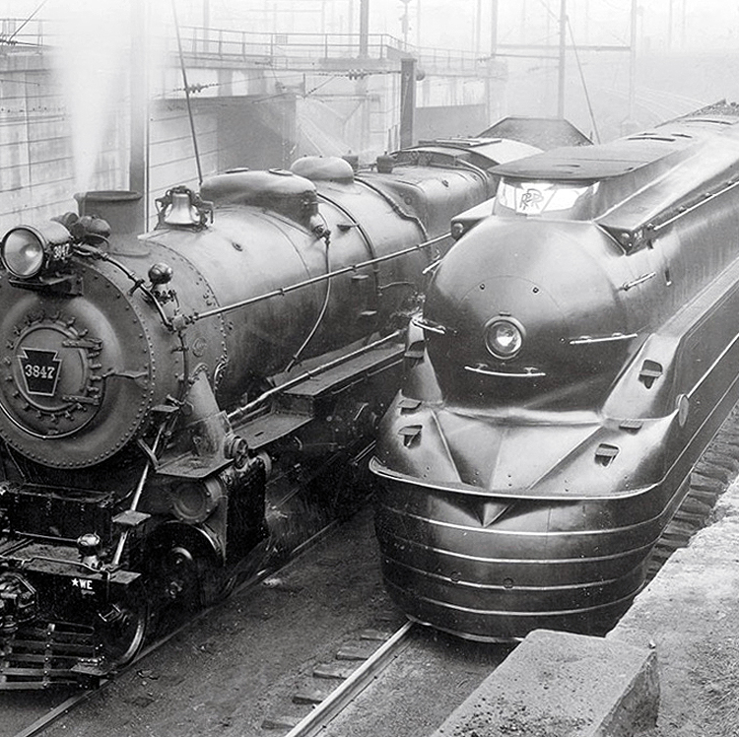
Problem Solved!
We had a technology solution to address depletion
Hosts preferred to use IPv6 when there was IPv6 available
The transition would operate automatically as networks enabled IPv6
So, we then shifted our collective attention elsewhere!
For the next decade or so
Until…

Slide 10
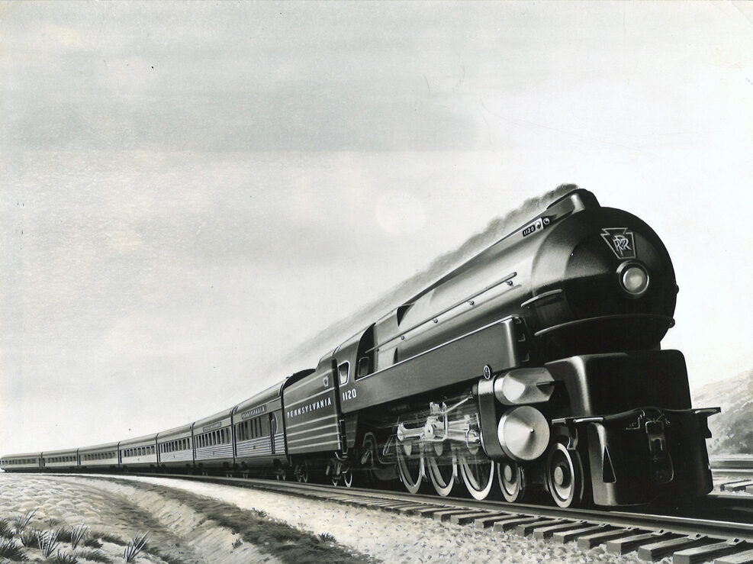
Accelerating Growth
2009
2010
189.6 Million Addresses
248.8 Million Addresses
The introduction of iPhones in ~2008
Panic and hoarding of IPv4 addresses

Slide 11
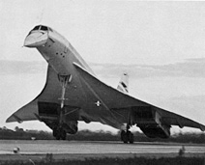
We had this plan …
IPv6 Deployment
Size of the
Internet
IPv6 Transition using Dual Stack
IPv4 Pool
Size
Time

Slide 12

Something wasn’t right!
We were meant to have completed the transition to IPv6 BEFORE we completely exhausted the supply channels of IPv4 addresses

Slide 13
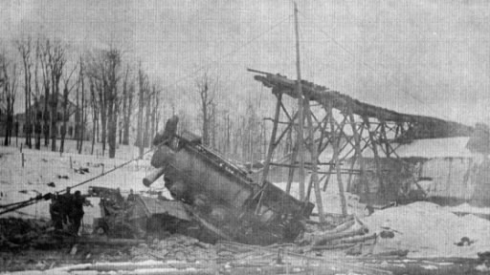
The 2012 IPv6 Transition Plan
IPv4 Pool Size
Size of the Internet
?
IPv6 Transition – Dual Stack
IPv6 Deployment
2004
2006
2008
2010
2012
Date

Slide 14
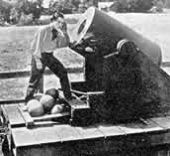
What now?
Despite the whinging from IETF purists over the compromise of a pristine end-to-end model there really was no other option:
The answer was NATs!

Slide 15
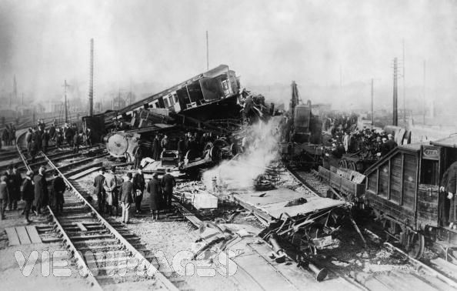
NATs
This low friction response to IPv4 address depletion had been used for more than a decade in client/server network architectures
Clients initiate a service transaction and only need an external address/port binding for the duration of the transaction
Servers sit in central data centres and share platform IP addresses using name-based distinguishers

Slide 16
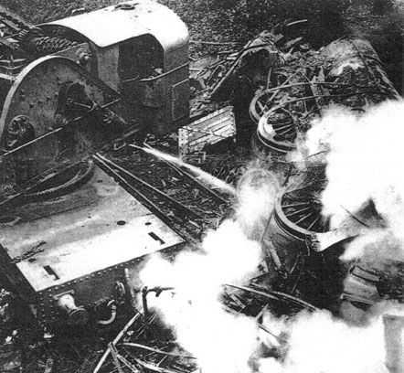
Implications
IPv4 addresses continued to be in demand far beyond the exhaustion of the RIR’s free space pools
In the transition environment, all new and expanding network deployments needed IPv4 service access and IPv4 addresses for as long as we were in this dual track transition
But the process was no longer directly controlled through RIR’s address allocation policies
Address access for IPv4 addresses is mediated by market pricing
And the large CDN actors appear to be dominating this space

Slide 17
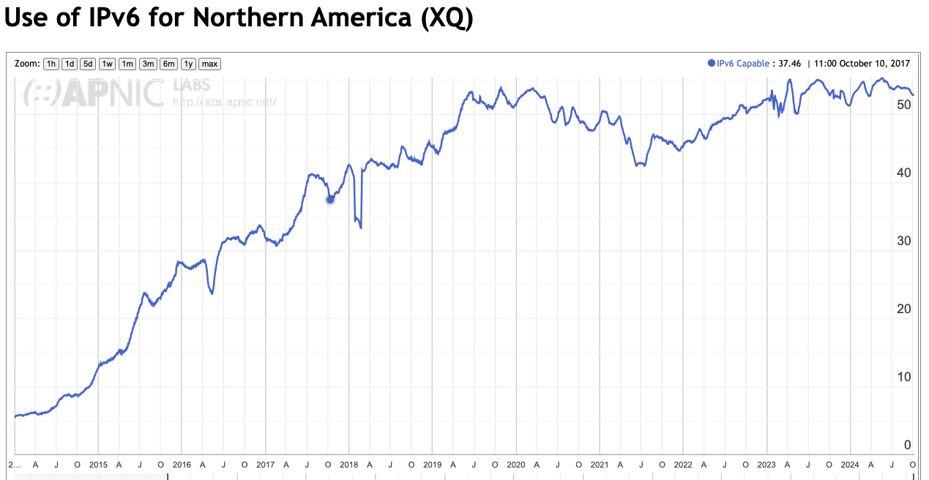
Not everyone is feeling the pressure to move to Dual Stack
% of Users
2020
2022
2024
https://stats.labs.apnic.net/ipv6/XQ

Slide 18

Why not?
Because we no longer operate within a strict address-based network architecture
Clients no longer use a permanent unique public IP address to communicate with servers
Servers no longer use a permanent unique public IP address to communicate with clients
Address scarcity takes on a different dimension when you don’t need public addresses to uniquely number every host and service

Slide 19
What’s driving change today?
From scarcity to abundance!
For many years, the demand for communications services outstripped available capacity
We used price as distribution function to moderate demand to match available capacity
But this is no longer the case – available capacity in the communications domain far outpaces demand

Slide 20
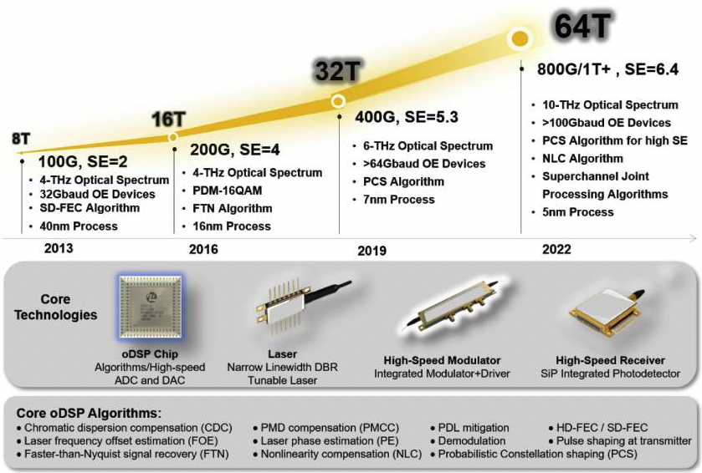
Abundant Capacity
Fibre cables continue to deliver massive capacity increases within relatively constant unit cost of deployment
https://www.ncbi.nlm.nih.gov/
(That 2022 number is probably low – at the end of 2022 we can pull 2.2T per lambda with a 190Gbd signal rate, giving a fibre capacity of 105T)

Slide 21
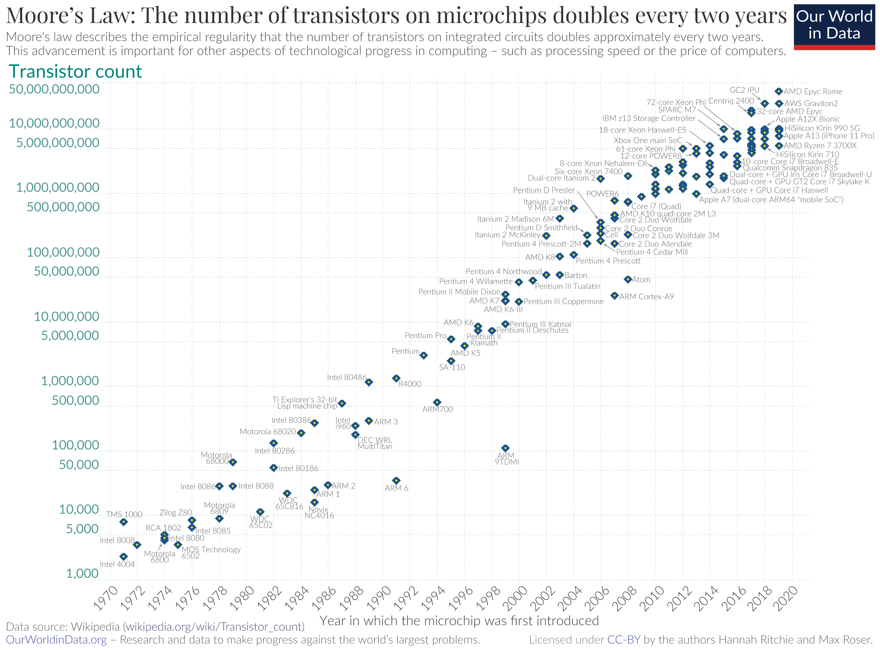
Abundant Compute Power
By Max Roser, Hannah Ritchie - https://ourworldindata.org/uploads/2020/11/Transistor-Count-over-time.png, CC BY 4.0, https://commons.wikimedia.org/w/index.php?curid=98219918

Slide 22
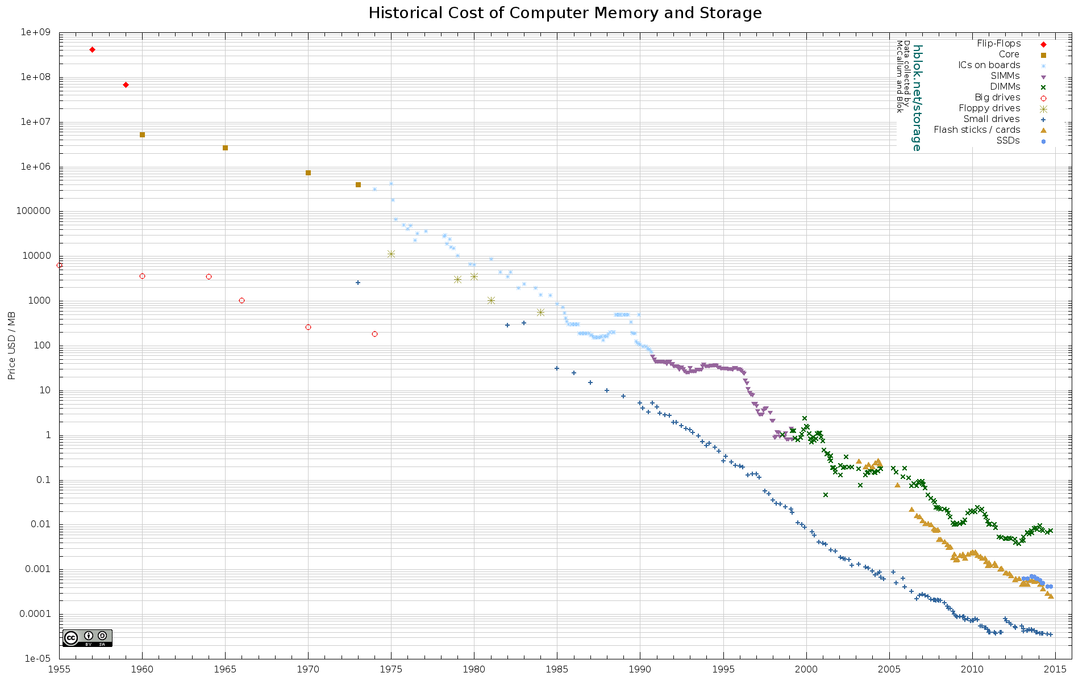
Abundant Storage
http://aiimpacts.org/wp-content/uploads/2015/07/storage_memory_prices_large-_hblok.net_.png

Slide 23
How can we use this abundance?
By changing the communications provisioning model from on demand to just in case
Instead of using the network to respond to users by delivering services on demand we’ve changed the service model to provision services close to the edge just in case the user requests the service
With this change we’ve been able to eliminate the factors of distance from the network and most network transactions occur over shorter network spans
What does a shorter network enable?

Slide 24

Bigger
Increasing transmission capacity by using photonic amplifiers, wavelength multiplexing and phase/amplitude/polarisation modulation for fibre cables
Serving content and service transactions by distributing the load across many individual platforms through server and content aggregation
The rise of high-capacity mobile edge networks and mobile platforms add massive volumes to content delivery
To manage this massive load shift we’ve stopped pushing content and transactions across the network and instead we serve from the edge

Slide 25

Faster
Reduce latency - stop pushing content and transactions across the network and instead serve from the edge
The rise of CDNs serve (almost) all Internet content and services from massively scaled distributed delivery systems.
The “Packet Miles” to deliver content to users has shrunk - that’s faster!
The development of high frequency cellular data systems (4G/5G) has resulted in a highly capable last mile access network with Gigabit capacity
Applications are being re-engineered to meet faster response criteria
Compressed interactions across shorter distances using higher capacity circuitry results in a much faster Internet

Slide 26
Better
If “better” means “more trustworthy” and “more privacy” then we are making progress at last!
Encryption is close to ubiquitous in the world of web services
TLS 1.3 is moving to seal up the last open TLS porthole, the SNI field
QUIC is sealing up the transport controls from the networks
Oblivious DNS and Oblivious HTTP is moving to isolate knowledge of the querier from the name being queried
The content, application, and platform sectors have all taken the privacy agenda up with enthusiasm, to the extent that whether networks are trustable or not doesn’t matter any more – all network infrastructure is uniformly treated as untrustable!

Slide 27

Cheaper
We are living in a world of abundant comms and computing capacity
And working in an industry when there are significant economies of scale
And it’s being largely funded by capitalising a collective asset that is infeasible to capitalise individually – the advertisement market
The result is that a former luxury service accessible to just a few has been transformed into an affordable mass-market commodity service available to all

Slide 28
And in all this, the money moved up the stack
apps
$$$
apps
transport
$$$
network
Internal
Transport +
session security
transport
media
network
media

Slide 29
So, who pays?
Networks need to make the investment to switch to a dual stack mode that includes IPv6
But neither the user base nor the content world really care
And they are certainly not going to pay a premium to the network operator for IPv6
And in the application service world, IP addresses are not the critical resource
We’ve changed the “currency” of networks!

Slide 30
A Network of Names
Today’s public Internet is largely a service delivery network using CDNs to push content and service as close to the user as possible
The multiplexing of multiple services onto underlying service platforms is an application-level function tied largely to TLS and service selection using SNI
The DNS is now used to perform “closest match” service platform selection, supplanting the role of routing
Most large CDNs run a BGP routing table with an average AS Path Length that is intended to converge to 1!

Slide 31
Is it Routing? Or Switching?
Let me repeat that, because it’s important:
Most large CDNs run a BGP routing table with an average AS Path Length that is converging to a value of 1!
The DNS is now used to perform “closest match” service platform selection, supplanting the role of routing
By volume, most of today’s Internet traffic is switched, not routed across the inter-AS space

Slide 32
A new Internet Architecture
We’ve moved from end-to-end peer networks to client/server asymmetric networks
We’ve replaced single platform servers-plus-network to replicated servers-minus-network with CDNs
Clients aren’t identified with a unique public IP address – clients are inside NATs are uniquely identified only in a local context
Individual services aren’t identified with a unique public IP address – services are identified in the DNS

Slide 33
A new Internet Architecture
We’ve moved from end-to-end peer networks to client/server asymmetric networks
We’ve replaced single platform servers-plus-network to replicated servers-minus-network with CDNs
Clients aren’t identified with a unique public IP address – clients are inside NATs are uniquely identified only in a local context
Individual services aren’t identified with a unique public IP address – services are identified in the DNS
We’ve moved from address-based networks to name-based services

Slide 34
What am I saying?
The slow uptake of IPv6 is not because this industry is chronically stupid or short sighted
There is something else going on here…

Slide 35
What am I saying?
IPv6 alone is not critical to a large set of end user service delivery environments
We’ve been able to take a 1980’s address-based architecture and scale it more than a billion-fold by altering the core reliance on distinguisher tokens within the network from addresses to names
There was no real lasting benefit in trying to leap across to just another 1980’s address-based architecture (with only a few annoyingly stupid differences, apart from longer addresses!)

Slide 36
Today’s Internet:
Names Matter
The DNS Matters
Addresses - not so much
Address-based Routing - not so much

Slide 37
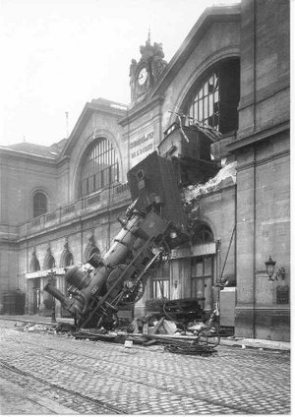
Thank You!

