Slide 1

Routing Security:
BGP and AS Path Validation
Geoff Huston
APNIC Labs

Slide 2

When ROA Validation is not enough
192.0.2.0/24
192.0.2.0/24 ASPath 2,1
AS1
AS3
192.0.2.0/24 ASPath 4,3,2,1
192.0.2.0/24 ASPath 3,2,1
AS5
ROA 192.0.2.0/24 OriginAS 1
AS2
AS4
192.0.2.0/24 ASPath 4,666,1
192.0.2.0/24 ASPath 666,1
AS 5 accepts this fake route as the Origin AS 1 Is matched by a ROA and the fake AS Path is shorter
192.0.2.0/24 ASPath 1
AS666
192.0.2.0/24 ASPath 1
AS 666 synthesises a path to 192.0.2.0/24
Using origin AS 1

Slide 3
BGP and AS Path
In BGP each eBGP speaker prepends it’s own AS to the AS_PATH attribute of a BGP UPDATE message
The AS Path is used in BGP loop detection as received updates that contain the local AS number in the AS Path are rejected
The AS Path is used in BGP route selection process where shorter AS paths are preferred over longer paths, modulo other local BGP route preference settings

Slide 4
AS Path Meddling
Manipulation of AS Paths can be used to:
  Manipulate third party’s route selection by denial (AS “poisoning”)
  Bias third party’s route selection by AS Path trimming or AS Path bloating
As long as the original Origin AS is left in the altered AS Path then simple ROV filtering will not detect this manipulation

Slide 5
Protecting the AS Path Attribute
The AS Path is* a “snail trail” of a route’s object’s propagation through the eBGP fabric
We can use this characteristic to create a digital signature train that allows a validator to confirm that the AS Path faithfully represents the AS propagation chain through the eBGP inter-AS topology
* That’s mostly true, but not always, and it can be an important distinction!

Slide 6
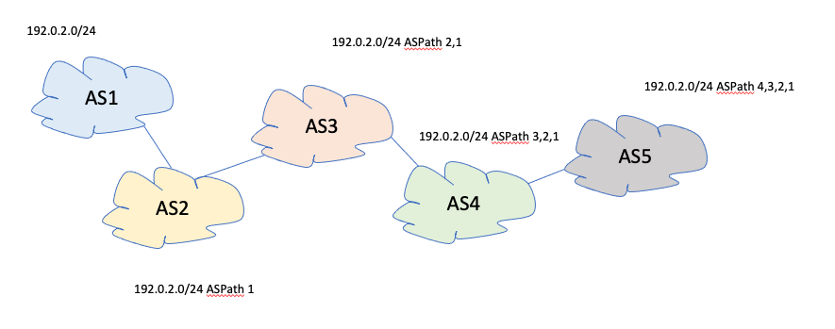
BGPSEC and AS Path Protection
Each eBGP speaker has a private key that is associated with the local AS, certified within the RPKI framework
When an update is passed to an eBGP peer the local BGP speaker takes the Path signature block, and adds the AS of the eBGP peer and signs this couplet with its own AS key.
192.0.2.0/24
AS2
AS3 AS4 AS5
Signed
AS1
Signed AS2
Signed AS3
Signed AS4

Slide 7
BGPSEC and AS Path Protection
The AS Path is now tightly tied to the route object propagation path
Attempts to manipulate this AS Path are now readily detectable

Slide 8
BGPSEC and AS Path Protection
BUT:
  Piecemeal partial deployment is not supported – protection is only afforded within “islands” of comprehensive deployment
  Routers need to hold private keys and perform signing functions
  Validating AS Path signature attributes can be computationally expensive as “detached filter list” validation model used in the Route Origin Validation implementation is not applicable to this form of Path validation
  Protocol Correctness is not Policy Correctness – certain forms of route leaks are not readily detected in this framework
BGPSEC is highly unlikely to be deployed in the mainstream of the Internet’s eBGP space

Slide 9
Other Approaches?
Do nothing and rely on Origin Validation?
But Origin Validation is not enough
  There are differing views as to how much this “not enough” is deficient.
  Some have made the case that a few basic assumptions about eBGP topology (PEER LOCK) and origin validation restricts the space of plausible synthetic AS Path constructs so as to make “not enough” more likely to be “good enough”.
  Others (including me!) have made that case that Origin Validation without some reasonably robust AS Path protection is about as useful as wearing an armour plating made of wet lettuce leaves!
Are there other approaches somewhere between “do nothing” and BGPSEC?

Slide 10
Cue: soBGP
Secure Origin BGP was proposed to the IETF back in 2003
AS Path “Plausibility”
  Each participating AS publishes a list of all its AS neighbours, signed by the local AS
AS1 connected to: AS2, signed AS1
AS2 connected to: AS1, AS3, signed AS2
AS3 connected to: AS2, AS4, signed AS3
AS4 connected to: AS3, AS5, signed AS4

Slide 11
soBGP Example
AS1 connected to: AS2, signed AS1
AS2 connected to: AS1, AS3, signed AS2
AS3 connected to: AS2, AS4, signed AS3
AS4 connected to: AS3, AS5, AS666, signed AS4
192.0.2.0/24
192.0.2.0/24 ASPath 2,1
AS1
AS3
192.0.2.0/24 ASPath 4,3,2,1
192.0.2.0/24 ASPath 3,2,1
AS5
AS2
AS4
192.0.2.0/24 ASPath 666,1
But AS 1 is not connected to AS 666!
192.0.2.0/24 ASPath 1
AS666
192.0.2.0/24 ASPath 1
AS 666 synthesises a path to 192.0.2.0/24
Using origin AS 1

Slide 12
soBGP
Lightweight process
Allows off-router processing and detached filter management
Allows for piecemeal partial validation
  (if you lie about me in an AS Path then you have to include one of my AS neighbours)

Slide 13
soBGP
BUT:
  No policy component – route leaks are not detected in soBGP
  Replaces “Path Validation” with “Path Plausibility”
    The extent to which AS Path manipulation can pass undetected depends on the uptake of AS adjacency publication

Slide 14
Routing: Path + Policy
Each network has routes learned from Customers, Peers and Providers
  Routes learned from customers are advertised to all other Customers, all Peers and all Providers
  Routes learned from Peers are advertised only to all Customers
  Routes learned from Providers are advertised only to Customers

Slide 15
“Valley Free” Routing
Provider
Peer
Peer
Customer
Every AS Path is a vector through the inter-AS topology
Every policy-compliant AS path is a sequence of
>= 0 Customer to Provider links
<= 1 Peer to Peer link
>= 0 Provider to Customer links

Slide 16
Valley Free Routing
192.0.2.0/24 ASPath 2,1
192.0.2.0/24 ASPath 3,2,1
AS3
AS4
Provider
Peer
Peer
Customer
Provider
Provider
Provider
AS2
192.0.2.0/24 ASPath 4,3,2,1
Provider
Customer
Customer
Customer
AS5
Customer
192.0.2.0/24 ASPath 1
AS6
AS1
192.0.2.0/24
If AS 6 leaks a route learned from AS 3 to AS 4 then it is creating a ”valley” in the path 4, 6, 3, 2, 1. Valley Free routing in AS4 could detect this leak if we knew this customer/provider relationship

Slide 17
ASPA = sparse soBGP + Valley Free
Each participating AS lists all of its authorised provider ASs and signs this list in an AS Provider Attestation (ASPA) object
  Similar to a ROA, its an “authority” to propagate a route learned from an AS, issued by that authorizing AS

Slide 18
ASPA = sparse soBGP + Valley Free
In a comprehensive deployment model every AS Path has the sequence of:
  >= 0 Customer-to-Provider (ASPA “forward”)
  <= 1 Peer-to-Peer (no ASPA)
  >= 0 Provider-to-Customer (ASPA “backward”)
In a partial deployment model an AS Path partially matches some “forward” ASPAs and then some “backward” ASPAs – any other ordering represents a policy violation!

Slide 19
ASPA Example
AS3
AS4
Provider
Peer
Peer
AS1: Providers: AS2
Customer
Provider
Provider
Provider
AS2
AS2: Providers: AS3
Provider
Customer
AS6: Providers: AS3, AS4
Customer
Customer
AS5
Customer
AS6
AS5: Providers: AS4
AS1
192.0.2.0/24

Slide 20
ASPA Example
4 to 6 is a “down” provider to customer
6 to 3 is an “up” customer to provider
4 to 6 to 3 is a “valley”
AS Path: 4 6 3
AS3
AS4
Provider
Peer
Peer
AS1: Providers: AS2
Customer
Provider
Provider
Provider
AS2
AS2: Providers: AS3
Provider
Customer
AS6: Providers: AS3, AS4
Customer
Customer
AS5
Customer
AS6
AS5: Providers: AS4
AS1
192.0.2.0/24

Slide 21
ASPA
Lightweight process
Allows off-router processing and detached filter management
Allows for piecemeal partial AS Path validation
Some/most route leaks are detectable if there are related ASPA attestations
  If a ASPA AS leaks then the path will contain a “down” then an “up” AS path

Slide 22
ASPA
BUT:
  Like soBGP, ASPA replaces “Path Validation” with “Path Plausibility”
    The extent to which AS Path manipulation can pass undetected depends on the uptake of ASPA publication

Slide 23
ASPA Status
Internet Draft: https://tools.ietf.org/html/draft-ietf-sidrops-aspa-profile-04
  Alexander Azimov, Qrator Labs
Likely to be published as an RFC (at some time in a vague and indefinite future!)
ASPA filtering Operational Model yet to be defined
  Is this another case of a split model where a processing engine sends updates to an AS Path filter maintained on eBGP speakers in a manner similar to ROA Validation?
  Or are the semantics of the ASPA validation process not readily mapped into filter rules and instead do they need to handling incoming AS Paths through onboard processing?

Slide 24
Questions?

