Slide 1
Some Thoughts on Integrity in Routing
Geoff Huston
Chief Scientist, APNIC

Slide 2
What we want…
We want the routing system to advertise the correct reachability information for “legitimately connected prefixes at all times
That means that we want to avoid:
  promulgating reachability for bogus address prefixes
  promulgating incorrect paths for reachable prefixes
  blocking paths for legitimately connected prefixes

Slide 3
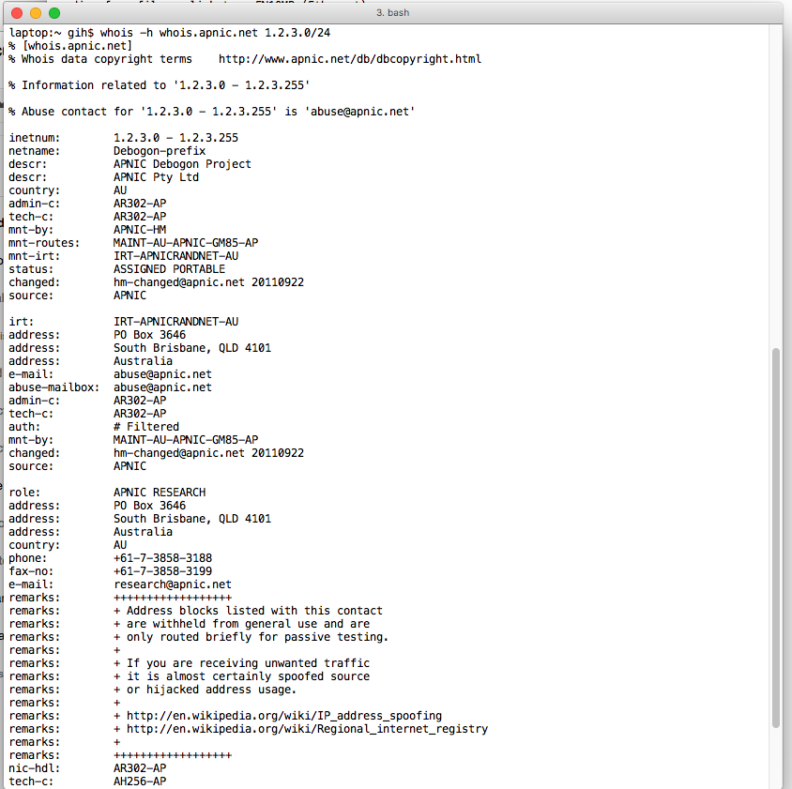
What do we do today?
I ask you to route my address prefix
You look for these addresses on whois*
If it all seems to match then accept the request and add it to the network filters for this customer
* As usual, its not as simple as that, as there are a number of whois servers, and you probably have to negotiate across a number of them to get what you are after, or to be assured that the entry is not in any of the registry data collections

Slide 4
What do we do today?
I ask you to route my address prefix
You look for these addresses on whois
If it all seems to match then accept the request and add it to the network filters for this customer
The awesome power of whois!
* As usual, its not as simple as that, as there are a number of whois servers, and you probably have to negotiate across a number of them to get what you are after, or to be assured that the entry is not in any of the registry data collections

Slide 5
What do we do today?
This is a manual process that
relies on ascii pattern matching
It is error prone, does not scale,
and provides no ongoing assurance
I ask you to route my address prefix
You look for these addresses on whois
If it all seems to match then accept the request and add it to the network filters for this customer
* As usual, its not as simple as that, as there are a number of whois servers, and you probably have to negotiate across a number of them to get what you are after, or to be assured that the entry is not in any of the registry data collections

Slide 6
What do we do today?
I ask you to route my net
You ask for me to provide a “Letter of Authority”
  Which is an effort to absolve you of all liability that may arise from announcing this route
You then add the to the network filters for this customer

Slide 7
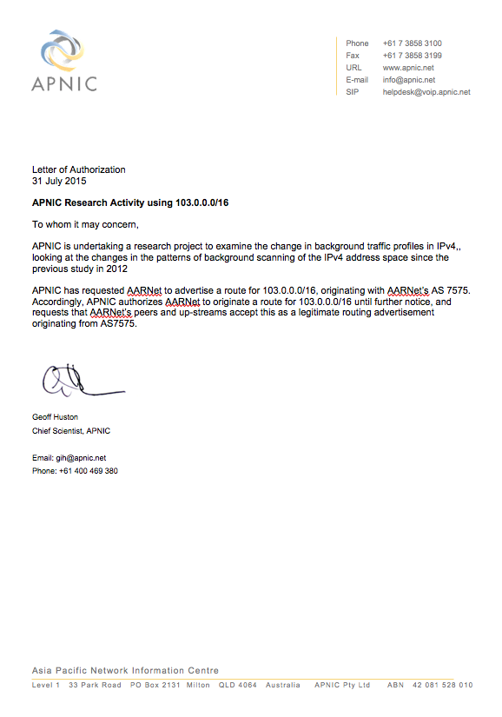
What do we do today?
I ask you to route my net
You ask for me to provide a “Letter of Authority”
  Which is an effort to absolve you of all liability that may arise from announcing this route
You then add the to the network filters for this customer

Slide 8
What do we do today?
This is little more than blame shifting
This is no good at detecting incorrect routing requests
But at least you are off the hook when the network police
come knocking!!
I ask you to route my net
You ask for me to provide a “Letter of Authority”
  Which is an effort to absolve you of all liability that may arise from announcing this route
You then add the to the network filters for this customer

Slide 9
What do we do today?
I ask you to route my net
You ask for me to enter the details in a route registry
Your routers’ access filters may be automatically generated from the route registry data that I entered

Slide 10
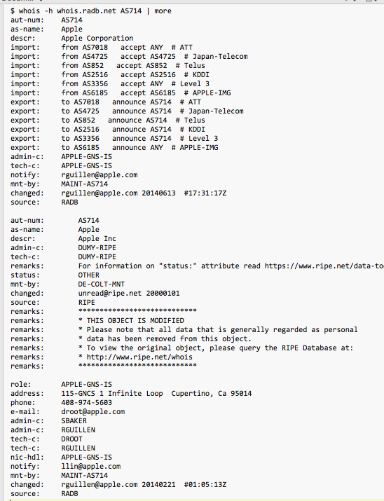
What do we do today?
I ask you to route my net
You ask for me to enter the details in a route registry
Your routers’ access filters may be automatically generated from the route registry data that I entered

Slide 11
What do we do today?
- How current is this data?
Is it complete?
Can it be tampered with?
Who entered this data? With what authority?
Can I trust it to use the stored information as an automatic filter generator for my network?
I ask you to route my net
You ask for me to enter the details in a route registry
Your routers’ access filters may be automatically generated from the route registry data that I entered

Slide 12
What do we do today?
A publicly accessible description of every import and export policy to every transit, peer, and customer, has proved to be extremely difficult to maintain
Today, we have many routing registries, not one, and the quality of the data in those registries is close to impossible to ascertain.
I ask you to route my net
You ask for me to enter the details in a route registry
Your routers’ access filters may be automatically generated from the route registry data that I entered
- How current is this data?
Is it complete?
Can it be tampered with?
Can I trust it to use the stored information as an automatic filter generator for my network?

Slide 13
What’s the problem here?
None of these approaches are very satisfactory as a complete solution to this problem
Let’s take a step back and see if we can use digital signature technology to assist here.
If we can, then we can construct automated systems that will recognise validly signed attestations about addresses and their use

Slide 14
Registry Role
The registry plays the role of a neutral third party ‘trust point’ that can provide an impartial record of which entity is the current holder of an IP address
Which is fine for humans, but of limited use to automated systems
How can we automate the validation function that allows an entity to validate whether or not a party is the current holder of an IP address?

Slide 15
Crypto to the rescue!
Public / Private keys can be really useful here
  I sign <something> using my private key and send it to you
  Using my public key you can be assured that:
    I signed this (and no one else)
    I cannot deny that I signed it
    What I signed has not been altered on the way between me and you
  The assurance can be automated, and does not necessarily rely on a manual process of matching ascii text

Slide 16
The RPKI
If I have the association between a public key and a number block registered by the RIR, then
  Instead of performing a human match between the registry entry and the party you can get the party to sign an attestation using their local private key
  If the attestation can be validated by the public key published by the RIR then you have automated the validation function and don’t need eyeballs to read web pages to validate the ‘rights’ of use of IP addresses

Slide 17

The RPKI Certificate Service
Enhancement to the RIR Registry
  Offers verifiable proof of the number holdings described in the RIR registry
Resource Certification is an opt-in service
  Number Holders choose to request a certificate
    Derived from registration data

Slide 18
BGPSEC: BGP + RPKI Origination
One approach is to look at the process of “permissions” that add an advertised address prefix to the routing system:
  The address holder is authorizing a network to originate a route advertisement into the routing system
The ROA is a digitally signed version of this authority. It contains
  An address prefix (and range of ‘allowed’ prefix sizes)
  An originating ASN
This allows others to check the validity of a BGP route origination:
If there is a valid ROA, and the origin AS matches the AS in the ROA, and the prefix length is within the bounds of the ROA, then the announcement has been entered into the routing system with the appropriate permissions

Slide 19
BGPSEC: BGP + RPKI Propagation
In BGP AS Path manipulation is also a problem
How can a BGPSEC speaker know that the AS Path in a BGP Update is genuine?
Answering this question in BGPSEC gets very messy very quickly!
In my opinion: It’s highly unlikely that we will see widespread uptake of BGPSEC anytime soon, if ever, largely due to the overheads associated with AS path signing

Slide 20
Errrr – why isn’t this being adopted by ISPs?
Cryptography and Certificate management are operationally challenging:
  which is often seen as one more thing to go wrong!
Validation of signed data is convoluted – maybe it should’ve been simpler
Its not just ROAs – you need AS Path protection as well
  As long as a hijacker includes your ROA-described originating AS in the faked AS PATH then the hijacker can still inject a false route
  If ROAs are challenging for operators, then BGPsec is far more so!

Slide 21
The Perfect is the Enemy of the Good
Maybe there are some “Good” things we can do right now instead of just waiting for BGPsec to be sorted out!

Slide 22
More Ideas?
Waiting for everyone to adopt a complex and challenging technology solution is probably not going to happen anytime soon
Are that other things we can do that leverage the RPKI in ways that improve upon existing measures?
  Use ROAs to digitally sign a LOA?
  Digitally sign whois entries?
  Digitally sign Routing Policy descriptions in IRRs
  Signed data could help a user to determine if the information is current and genuine
  This would not directly impact routing infrastructure, but instead would improve the operators’ route admission process to automatically identify routing requests that do not match signed registry / routing database information

Slide 23
What should we do?
We could keep on thinking about how to make a routing infrastructure that is impervious to attempts to coerce it into false states
  But it seems that we are not sure how to do this, and not sure who would pay the cost of trying to do this!
AND/OR
Perhaps we should undertake some focussed work on open BGP monitoring and alarm services that allow us to detect and identify routing issues as they arise, and assist network operators to respond quickly and effectively
Notes:
It’s a bit like fires and the fire brigade
We could insist that all buildings, clothes, machines, etc are built using non-flammable material
But that’s unrealistic
So we also maintain a fire brigade who are there to respond to fires and put them out

Slide 24
Thanks!

